Slide 1

Mult-touch-midAir-and Motion for Virtual and Augmented Reality (TAM) 3D CodeBlocks
Team Members: Fernando de Zayas, Taufiq Islam Product Owner: Dr. Francisco R. Ortega
Instructor: Dr. Francisco R. Ortega, Masoud Sadjadi School of Computing and Information Sciences Florida International University
Final Presentation
Spring 2017
The logo of your project
Notes:
7 seconds.( I will select 2 best slides (i will give them extra points and students will present for CIS committee)
Greet your audience, thank them for attending your presentation, introduce yourself, introduce your project, introduce your team members, and quickly indicate what each of you did in a high-level manner, and put more emphasis on your part/contribution.

Slide 2
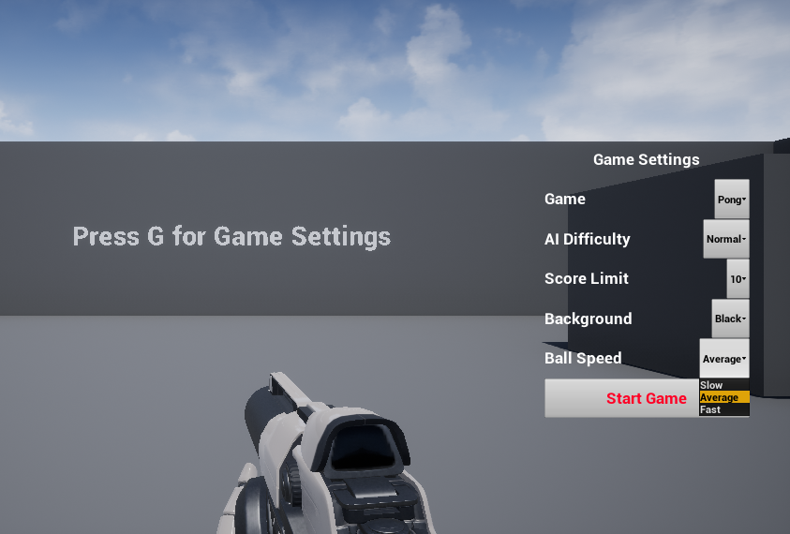
Project definition
Main Area of the Project, where you changes levels and settings
Notes:
10 seconds.
Introduce the problem that the whole project (in all versions) tackles with GIF or screenshot.

Slide 3
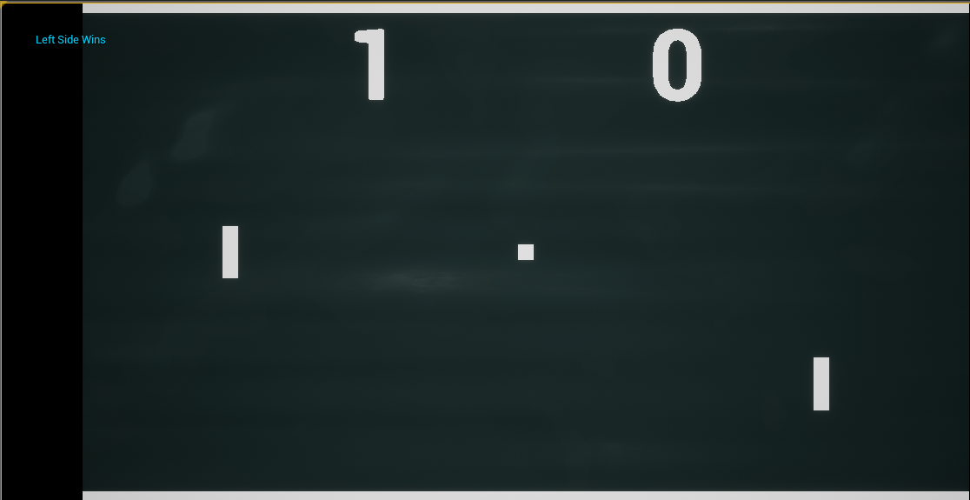
Project definition
Pong Level with customized settings
Notes:
20 seconds.
Introduce the problem that the your project (in new version) tackles with GIF or screenshot.

Slide 4
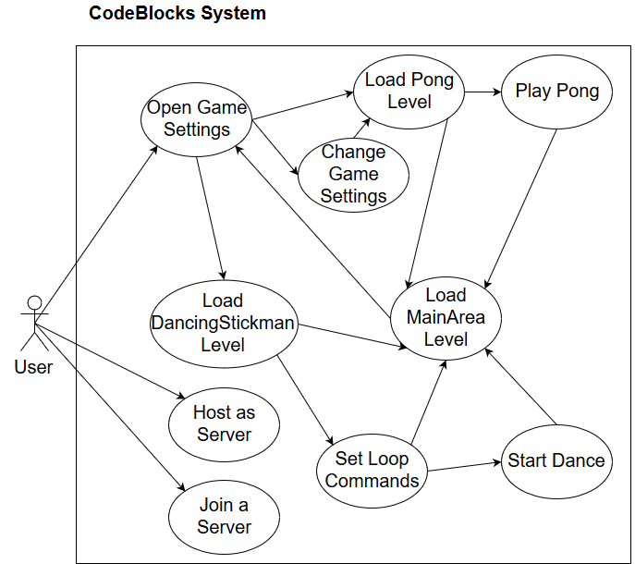
Requirements: Use Cases
Notes:
5 seconds
Show the Use Case Diagram for the whole project. Highlight your use cases.

Slide 5
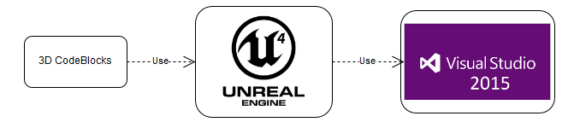
System Design: Architecture
Event-Driven Architecture
Deployment: One to two computers capable of running Unreal Engine 4
Notes:
20 seconds
System design: Highlight the parts that you contributed to them.
1. System decomposition; identify the architecture patterns used
2. System deployment – h/w and s/w requirements

Slide 6
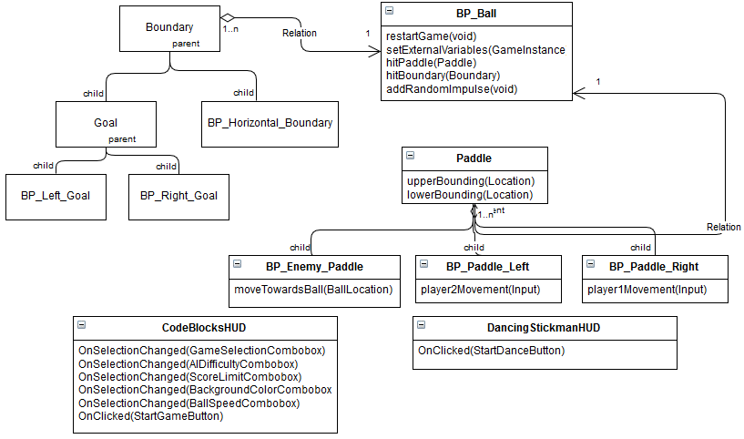
Minimal Class Diagram
Notes:
10 seconds.Minimal class diagram. Highlight the classes that you created/modified
Identify the design patterns used (one or more slides).

Slide 7
Design Patterns
Lazy Initialization : Before a level is needed, it is not loaded.
Singleton : HUD blueprints for each level are Singletons and referenced as such.
Marker: The custom GameMode classes have no functionality but define metadata such as which class is the default player character
Null Object: Every blueprint that requires an object or reference will not allow compilation until one of the correct type is provided.

Slide 8
User Stories
1.#1305 Finish Variable Code Blocks
2.#1207 Create Variable Code Blocks
3.#1309 Finish Loop Blocks
4.#1212 Networking and Multiplayer Functionality
5.#1294 Cross-platform Multiplayer Functionality
Notes:
5 seconds.
List the user stories that you worked on them.(put in order of importance). Stay focused on the parts that you have been working.

Slide 9
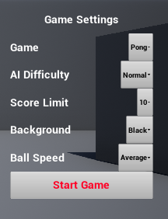
Finish Variable Code Blocks
Changes the values of a
level from a different level
Transferring the values
between levels took various
attempts
Notes:
60 seconds
The tile of user story
The most important user story you worked on it. You have to describe this one very well and be proud of that.
Please present and show the complexity of your work, code, algorithms, and technical challenges and technologies you have used. (you could use screenshot if you want. Visual presentations are better than text presentation)
Go into the details of the most important/significant tasks using bullet lists or visual graphs or state chart diagram
Sequence Diagram for this user story is mandatory (in another separate page if required)
Demo using screenshots or GIF (in another separate page if required)

Slide 10
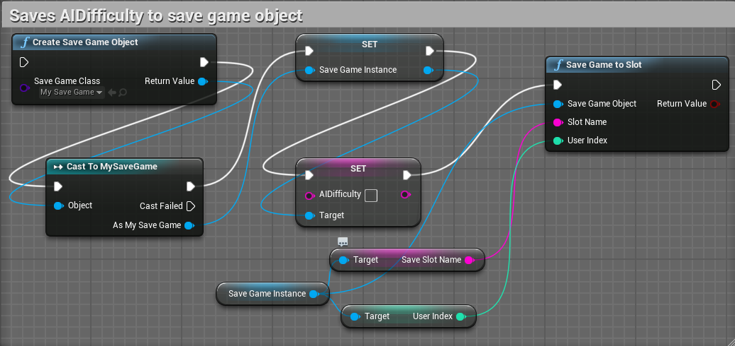
Finish Variable Code Blocks
Attempt with custom SaveGame object

Slide 11
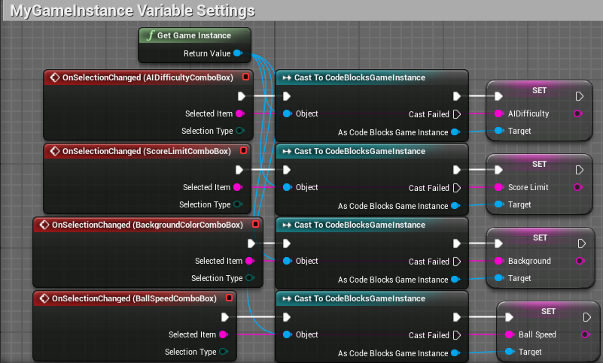
Finish Variable Code Blocks
Successful attempt with custom GameInstance

Slide 12
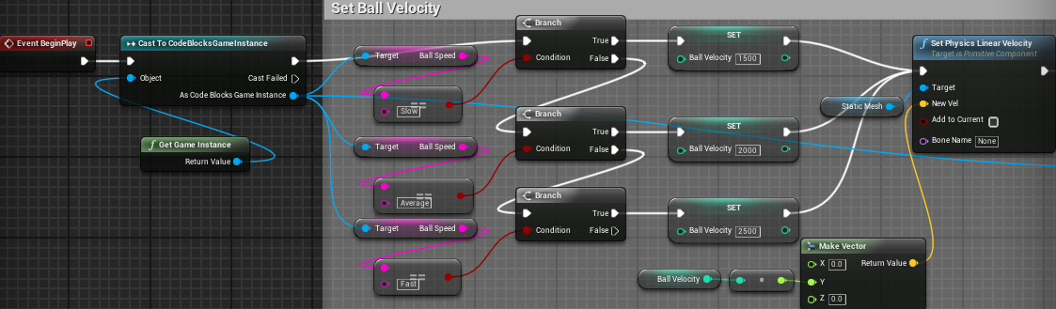
Finish Variable Code Blocks
Setting the saved value in a custom blueprint

Slide 13
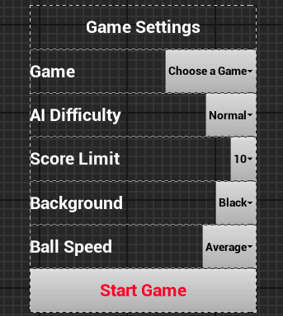
Create Variable Code Blocks
Final design of the Game
Settings set for future
use
Logic for custom
GameModes setup redone
Notes:
20 seconds
The tile of user story
Please present and show the complexity of your work, code, algorithms, and technical challenges and technologies you have used. (you could use screenshot if you want. Visual presentations are better than text presentation) - Go into the details of the most important/significant tasks using bullet lists or visual graphs or state chart diagram - Demo using screenshots or GIF (in another separate page if required)
Sequence Diagram for this user story is optional

Slide 14
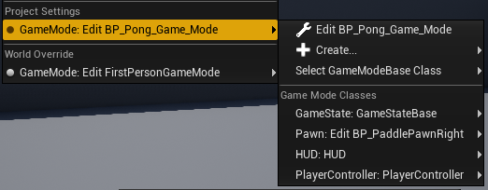
Create Variable Code Blocks
GameModes set the basic settings of a level, such as default player character and control inputs
Unable to be changed in blueprints, only from a dropdown menu

Slide 15
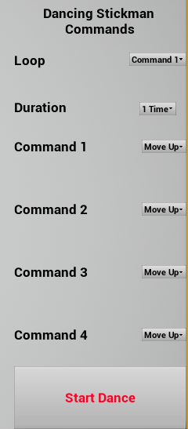
Finish Loop Blocks
Redesign of the original
structure for commands
and looping
Successful looping through
the commands
accomplished
Notes:
20 seconds
The tile of user story
Please present and show the complexity of your work, code, algorithms, and technical challenges and technologies you have used. (you could use screenshot if you want. Visual presentations are better than text presentation) - Go into the details of the most important/significant tasks using bullet lists or visual graphs or state chart diagram - Demo using screenshots or GIF (in another separate page if required)
Sequence Diagram for this user story is optional

Slide 16
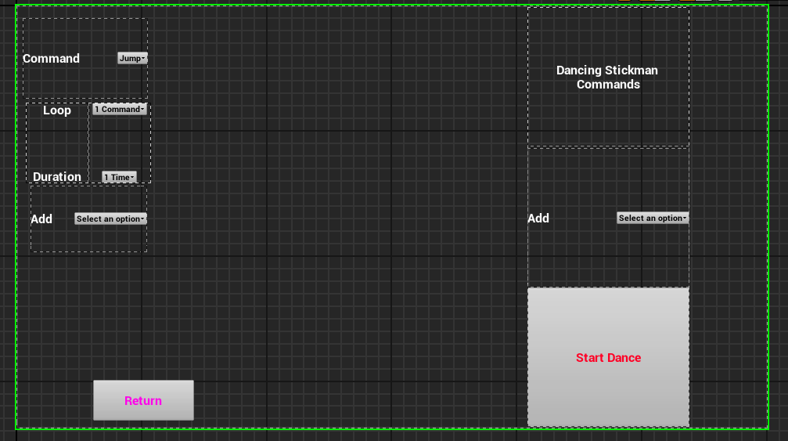
Finish Loop Blocks
Original design, which dynamically added blocks to HUD
Notes:
20 seconds
The tile of user story
Please present and show the complexity of your work, code, algorithms, and technical challenges and technologies you have used. (you could use screenshot if you want. Visual presentations are better than text presentation) - Go into the details of the most important/significant tasks using bullet lists or visual graphs or state chart diagram - Demo using screenshots or GIF (in another separate page if required)
Sequence Diagram for this user story is optional

Slide 17
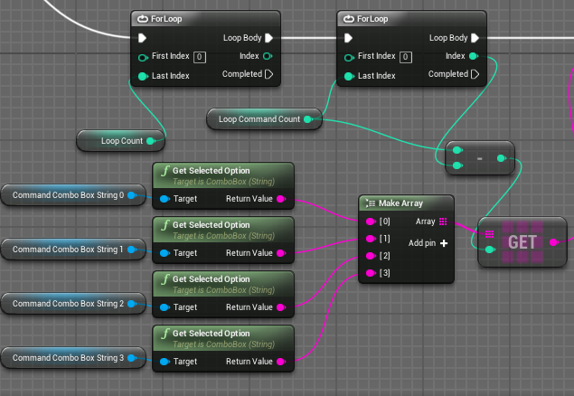
Finish Loop Blocks
Logic to loop through the chosen commands
Notes:
20 seconds
The tile of user story
Please present and show the complexity of your work, code, algorithms, and technical challenges and technologies you have used. (you could use screenshot if you want. Visual presentations are better than text presentation) - Go into the details of the most important/significant tasks using bullet lists or visual graphs or state chart diagram - Demo using screenshots or GIF (in another separate page if required)
Sequence Diagram for this user story is optional

Slide 18
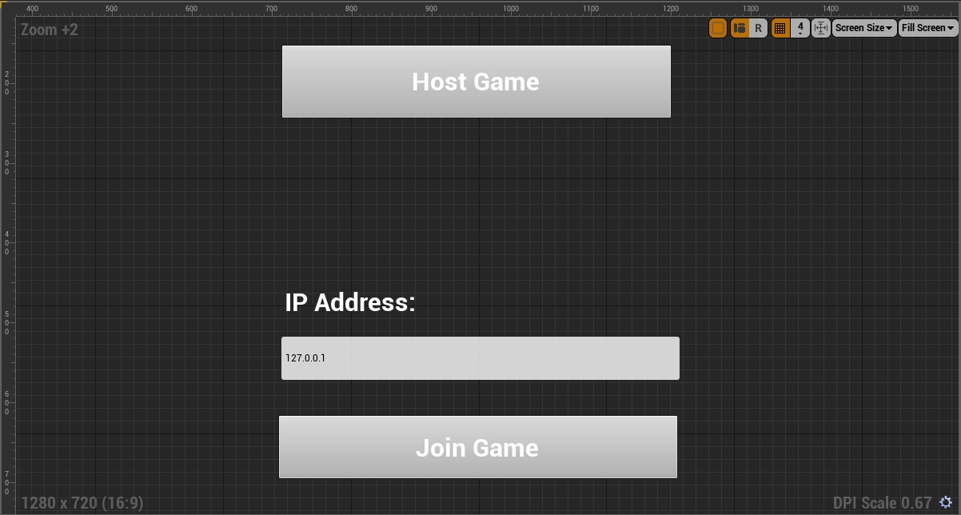
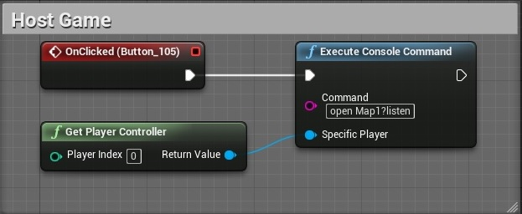
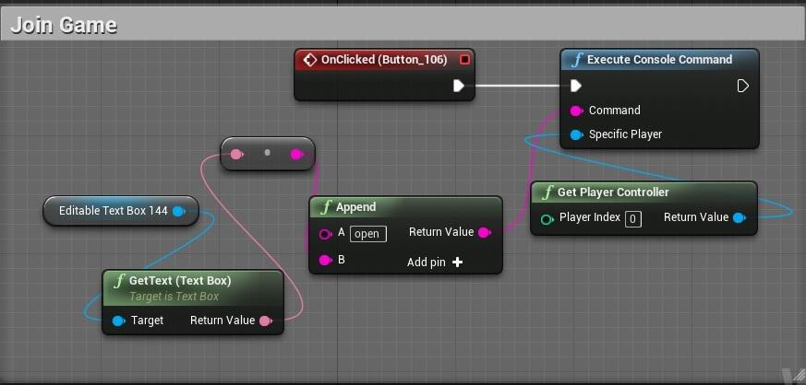
Networking and Multiplayer Functionality
Create a user-menu that allows players to host a new session or join a session in progress.
Notes:
20 seconds
The tile of user story
Please present and show the complexity of your work, code, algorithms, and technical challenges and technologies you have used. (you could use screenshot if you want. Visual presentations are better than text presentation) - Go into the details of the most important/significant tasks using bullet lists or visual graphs or state chart diagram - Demo using screenshots or GIF (in another separate page if required)
Sequence Diagram for this user story is optional

Slide 19
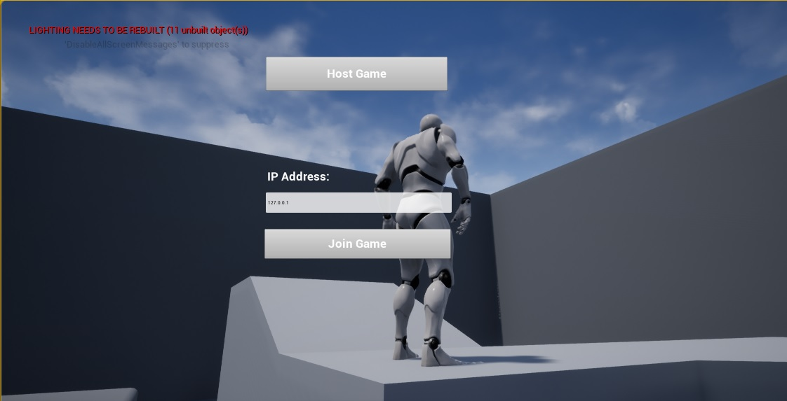
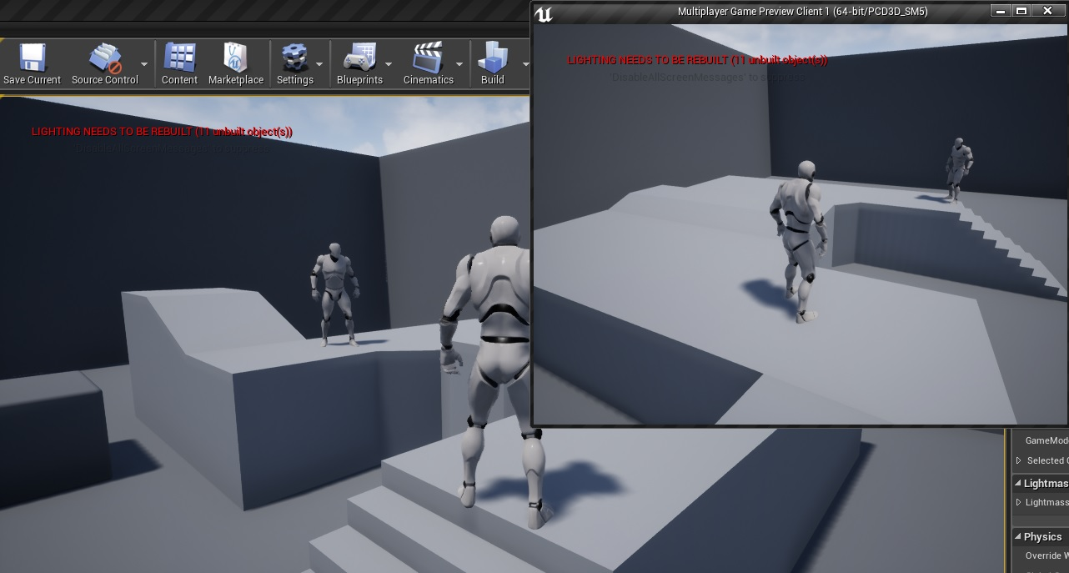
Networking and Multiplayer Functionality
User hosting a new session
Two users in the same session
Notes:
20 seconds
The tile of user story
Please present and show the complexity of your work, code, algorithms, and technical challenges and technologies you have used. (you could use screenshot if you want. Visual presentations are better than text presentation) - Go into the details of the most important/significant tasks using bullet lists or visual graphs or state chart diagram - Demo using screenshots or GIF (in another separate page if required)
Sequence Diagram for this user story is optional

Slide 20
Cross-platform Multiplayer Functionality
Unreal Engine 4 Network Replication System is platform independent
The same input controls / network code will work on any of the platforms natively supported by UE4
Notes:
20 seconds
The tile of user story
Please present and show the complexity of your work, code, algorithms, and technical challenges and technologies you have used. (you could use screenshot if you want. Visual presentations are better than text presentation) - Go into the details of the most important/significant tasks using bullet lists or visual graphs or state chart diagram - Demo using screenshots or GIF (in another separate page if required)
Sequence Diagram for this user story is optional

Slide 21
Test Suites and Test Cases
3D_CodeBlocks_UT_004 (Sunny Day)
Purpose:Verify that the level change between the MainArea and DancingStickman levels works in both directions
Pre-condition: CodeBlocksHTCVive project is installed on a computer with Unreal Engine 4.15
Input:
User opens the Game Settings menu
User selects Dancing Stickman as the game to play
User clicks Start Game
User clicks Return
Expected Results: User spawns in the correct location with the correct camera in the MainArea and DancingStickman levels
Actual Result: User spawned in the correct location with the correct camera in the MainArea and DancingStickman levels
Status (Fail/Pass): Pass
Notes:
10 seconds
A description of verification process and Test Suites and Test Cases for one of the use cases.
1 One sunny day and one rainy day for the implemented use cases (one or more slides).
2 Automated test scripts for the implemented use cases (if any) (one or more slides).

Slide 22
Test Suites and Test Cases
3D_CodeBlocks_UT_002 (Rainy Day)
Purpose: Verify that the player character spawns and accepts user input after the P1_Main level
Pre-condition: CodeBlocksHTCVive project is installed on a computer with Unreal Engine 4.15
Input:
User opens the Game Settings menu
User selects pong as the game to play
User clicks Start Game
User clicks 1P Pong
User presses the up and down arrow keys
Expected Results: The right side player controlled paddle spawns and moves according to arrow key input
Actual Result: The right side player controlled paddle spawned and moved according to arrow key input
Status (Fail/Pass): Pass
Notes:
10 seconds
A description of verification process and Test Suites and Test Cases for one of the use cases.
1 One sunny day and one rainy day for the implemented use cases (one or more slides).
2 Automated test scripts for the implemented use cases (if any) (one or more slides).

Slide 23


Summary
3D CodeBlocks is designed to facilitate the education of students with no background in Computer Science in the field of basic programming concepts.
Documentation for this project was recorded on Mingle, Google Drive, and Github, using Scrum methodology.
Contact Information:
Fernando de Zayas fdeza001@fiu.edu
Taufiq Islam tisla@005@fiu.edu
Notes:
10 seconds
Summarize your contribution, mention your effort for Scrum, Mingle, Github, Google Drive Documentation and minutes
Include your contact information
Ask if anyone has any questions for you.
Thank your audience

